Slide 1
Chapter 1 Binary Systems

Slide 2
Digital Systems
Digital vs. Analog
Digital: a limited number of discrete values
Analog: a uncountable number of continuous values
Digits and bits
Digits: discrete elements
Bits: binary digits
Most digital systems use bits to represent information.
→ Need to understand the binary system.
Digital computer is a digital system that performs various computational tasks.

Slide 3
Digital Computers
A computer system is composed of hardware and software.
Hardware
Consists of electronic components & electromechanical devices.
Software
Consists of programs composed of a sequential instructions.
System software
Collection of programs to make a effective use of computers
Ex: Operating System, Compilers

Slide 4
Basic Structure of Digital Computer
Memory
Central Processing Unit (CPU)
Control Unit
(CU)
Arithmetic
Logic Unit
(ALU)
Input Devices
Output Devices

Slide 5
HW in Digital Systems
Digital/Binary Systems
Computer system, digital TV, digital camera, …
IC (Integrated Circuits)
Combinational
Logic
Sequential Logic
Synchronous
Asynchronous
Logic
Gate
Memory
Memory
Logic
Gate
Logic
Gate
Clock

Slide 6
Number System
Consists of two things:
Base or Radix value
Set of coefficients
Example: the common decimal system
Base: 10
Set of coefficients = {0, 1, 2, 3, 4, 5, 6, 7, 8, 9}

Slide 7
Base-r System
In general, a base-r system
Base: r
Set of coefficients = {0, 1, 2, …, r-1}
Example:
(a₅a₄a₃a₂a₁a₀.a₋₁a₋₂a₋₃)_{r}
= a_{n}r^{n}+a_{n-1}r^{n-1}+...+a₂r²+a₁r+a₀+a₋₁r⁻¹+a₋₂r⁻²+...+a_{-m}r^{-m}
7392 = 7 × 10³ + 3 × 10² + 9 × 10¹ +2 × 10⁰
(11010.11)₂ =1×2⁴+1×2³+0×2²+1×2¹+0×2₀
+1×2⁻¹+1×2⁻²
= (26.75)₁₀

Slide 8
Decimal Number System
Consider: 503.21
Arithmetically, shorthand for a radix polynomial:
5x(10²) + 0x(10) + 3x(10⁰) + 2x(10⁻¹) + 1x(10⁻²)
Other notation: (503.21)₁₀

Slide 9
Other Number Systems
Binary
Base: 2
Set of coefficients = {0, 1}
Octal
Base: 8
Set of coefficients = {0, 1, 2, 3, 4, 5, 6, 7}
Hexadecimal
Base: 16
Set of coefficients = {0, 1, 2, 3, 4, 5, 6, 7, 8, 9, A, B, C, D, E, F}

Slide 10
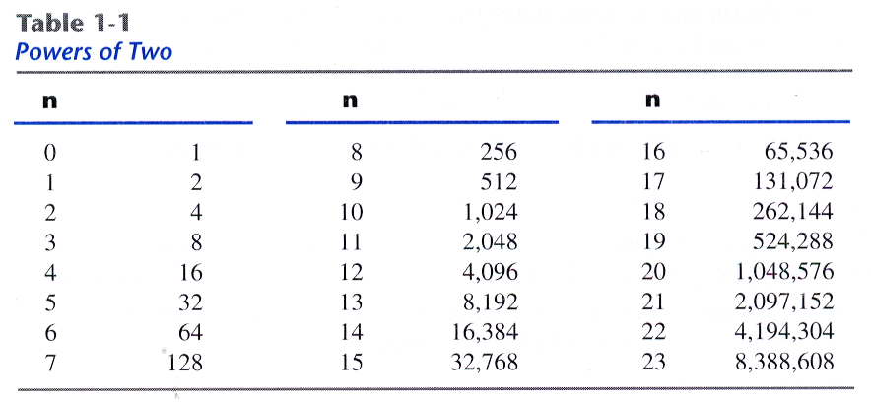
Binary Number
Binary
Bit: a digit in a binary number
Byte: 8 bits
N bits → from 0 to 2^{N}-1
2¹⁰ = 1Kilo
2²⁰ = 1Mega
2³⁰ = 1Giga
2⁴⁰ = 1Tera

Slide 11
Arithmetic Operations in Binary System
The same rules as in decimal
Augend | 101101 | Minuend: | 101101 | Multiplicand: | 1011
Addend | + 100111 | Subtrahend: | - 100111 | Multiplier: | x 101
sum | 1010100 | Difference: | 000110 |  | 1011
 |  |  |  |  | 0000 .
 |  |  |  |  | 1011 .
 |  |  |  | Product: | 110111
addition
subtraction
0 + 0 = 0 carry=0
0 + 1 = 1 carry=0
1 + 0 = 1 carry=0
1 + 1 = 0 carry=1
0 - 0 = 0 borrow=0
1 - 0 = 1 borrow=0
0 - 1 = 1 borrow=1
1 - 1 = 0 borrow=0

Slide 12
Number Base Conversion
If the number includes a radix point,
Can convert integer part by performing repeated divisions
Accumulate the remainder digits
Can convert fraction part by performing repeated multiplications
Accumulate the integer product digits
12043.983
Integer part
Fraction part

Slide 13
Number Base Conversion
Example: Convert decimal 41 to binary.
 | Integer Quotient |  | Remainder | Coefficient
41/2 = | 20 | + | ½ | a₀ = 1
20/2 = | 10 | + | 0 | a₁ = 0
10/2 = | 5 | + | 0 | a₂ = 0
5/2 = | 2 | + | ½ | a₃ = 1
2/2 = | 1 | + | 0 | a₄ = 0
1/2 = | 0 | + | ½ | a₅ = 1
Integer | Remainder
41
20 | 1
10 | 0
5 | 0
2 | 1
1 | 0
0 | 1
answer : (41)10 = (a₅a₄a₃a₂a₁a₀)₂ = (101001)₂

Slide 14
Number Base Conversion
Example1-2: decimal 153 to octal
153
19 | 1
2 | 3
0 | 2 = (231)₈

Slide 15
Number Base Conversion
Example 1-3: (0.6875)₁₀ to binary
Answer:(0.6875)10 = (0.a₋₁a₋₂a₋₃a₋₄)₂ = (0.1011)₂
 | Integer |  | Fraction | Coefficient
0.6875 x 2 = | 1 | + | 0.3750 | a₋₁ = 1
0.3750 x 2 = | 0 | + | 0.7500 | a₋₂ = 0
0.7500 x 2 = | 1 | + | 0.5000 | a₋₃ = 1
0.5000 x 2 = | 1 | + | 0.0000 | a₋₄ = 1

Slide 16
General Base (Radix) Conversion: Integer Part
Given a value X represented in a source system with radix B_{s}, represent the same number in a destination system with radix B_{d}
Consider the integer part of the number, X_{I} in the B_{d} system
R is the Desired digit (LSD) → can repeatedly divide to obtain converted value

Slide 17
General Base (Radix) Conversion: Fraction Part
Consider the fraction part of the number, X_{I} in the B_{d} system
P_{I} is the desired digit → can multiply by the B_{d} value

Slide 18
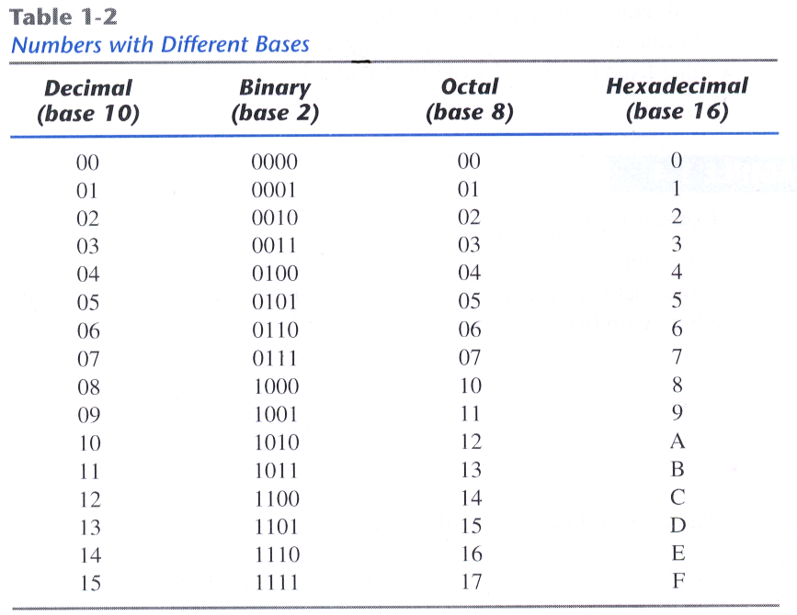
Octal and Hexadecimal Numbers
Binary-Octal-Hexadecimal

Slide 19
Octal and Hexadecimal Numbers
Binary to Octal
Grouping 3 digits in binary and assigning the octal
Binary to Hexadecimal
Grouping 4 digits in binary and assigning the hexadecimal
( 10 110 001 101 011 . 111 100 000 110 )₂ = (26153.7406)₈
2 6 1 5 3 7 4 0 6
( 10 1100 0110 1011 . 1111 0010 )₂ = (2C6B.F2)₁₆
2 C 6 B F 2

Slide 20
Complements
Are used in digital computers for simplifying the subtraction and for logical manipulation
Two types of complements for base-r system
r’s complement
(r-1)’s complement

Slide 21
Diminished Radix Complement
Given N in base r having n digits,
(r-1)’s complement = (r^{n} – 1) – N
For decimal, 9’s complement
The 9’s complement of 546700 = 999999-546700=453299
The 9’s complement of 012398 = 999999- 012398=987601
For binary, 1’s complement
Formed by changing 1’s to 0’s and 0s’ to 1’s.
The 1’s complement of 1011000 = 0100111
The 1’s complement of 0101101 = 1010010

Slide 22
Radix Complement
Given N in base r having n digits,
r’s complement = r^{n}– N
Adding 1 to (r-1)’s complement
For decimal, 10’s complement
The 10’s complement of 012398 = 987602
The 10’s complement of 246700 = 753300
For binary, 2’s complement
The 2’s complement of 1101100 = 0010100
The 2’s complement of 0110111 = 1001001

Slide 23
Subtraction Implementation
The direct method of subtraction → borrow concept
When the minuend digit is smaller than the subtrahend digit, a 1 from a higher significant position is borrowed.
It works well with paper and pencil.
How to implement the subtraction with digital hardware ?

Slide 24
Subtraction with Complements (1)
The subtraction of two n-digit unsigned numbers M - N in base r
Add the minuend, M, to the r’s complement of the subtrahend. → M + (r^{n}-N) = M – N + r^{n}
If M≥N, the sum will produce an end carry, r^{n}, which can be discarded; what is left is the result M – N.
If M<N, the sum does not produce an end carry and is equal to r^{n} – (N – M ),which is the r’s complement of (N – M); to obtain the answer, take r’s complement of the sum and place a negative sign in front.

Slide 25
Subtraction with Complements (2)
Using 10’s complement, subtract 72532-3250
Using 10’s complement, subtract 03250-72532
No end carry: the answer is negative.
→ take 10’s complement and place negative sign in front.
Answer: -69282
In case of M≥N
In case of M<N
M = | 72532
10’s complement of N = | + 96750
Sum = | 169282
Discard end carry 10⁵ = | -100000
Answer = | 69282
M = | 03250
10’s complement of N = | +27468
Sum = | 30718

Slide 26
Subtraction with Complements (3)
Subtraction using 2’s complement
X=1010100 and Y = 1000011
X-Y
Y-X
No end carry
The answer is Y-X = -(2’s complement of 1101111)=-0010001
X = | 1010100
2’s complement of Y = | +0111101
Sum = | 10010001
Discard end carry 2⁷ = | -10000000
Answer: X-Y = | 0010001
Y = | 1000011
2’s complement of X = | +0101100
Sum = | 1101111

Slide 27
Subtraction with Complements (4)
Subtraction using 1’s complement
X=1010100 and Y = 1000011
X-Y
Y-X
No end carry
The answer is Y-X = -(1’s complement of 1101110)=-0010001
X = | 1010100
1’s complement of Y = | +0111100
Sum = | 10010000
End-around carry = | + 1
Answer: X-Y = | 0010001
Y = | 1000011
1’s complement of X = | +0101011
Sum = | 1101110

Slide 28
Signed Binary Numbers
How to represent negative numbers?
In ordinary,
Positive number: (+) sign
Negative number: (-) sign
In computer HW,
A bit placed in the leftmost position of the number is used for a sign bit.
Positive: 0
Negative: 1
Signed-complement system
Negative number is indicated by its complement
→ 2’s complement in the most common
Three different way to represent -9 with 8bits
Signed-magnitude: 100010001
Signed-1’s complement: 11110110
Signed-2’s complement: 11110111

Slide 29
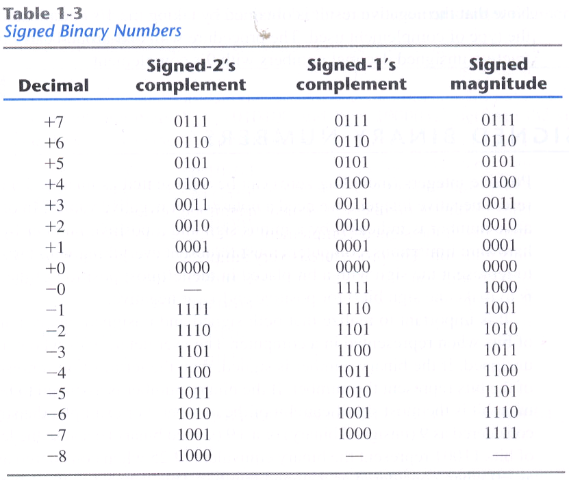
Signed Binary Numbers

Slide 30
Arithmetic Operation of Signed Binary Numbers
Arithmetic addition of two signed binary numbers
Does not require comparison, only addition.
A carry out of the sign-bit position is discarded.
Arithmetic subtraction
(±A)-(+B) = (±A)+(-B)
(±A)-(-B) = (±A)+(+B)
+6 |  | 00000110 |  | -6 |  | 11111010
+13 |  | 00001101 |  | +13 |  | 00001101
+19 |  | 00010011 |  | +7 |  | 00000111
+6 |  | 00000110 |  | -6 |  | 11111010
-13 |  | 11110011 |  | -13 |  | 11110011
-7 |  | 11111001 |  | -19 |  | 11101101
Carry out is
discarded

Slide 31
Binary Codes
Digital system manipulates
not only binary numbers
but also many other discrete elements of information.
→represented with binary code as symbols.
Code assigning rule
n-bit binary code → n distinct combinations of 0’s and 1’s
Each element must be assigned a unique binary bit combination (code): no two elements can have the same value → avoid ambiguity.
to code 2^n distinct elements
Minimum number of bits → n bits
No maximum number of bits

Slide 32
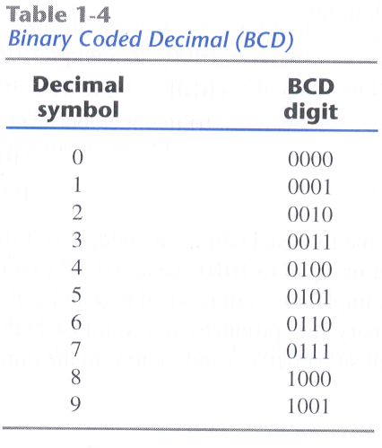
Binary Coded Decimal (BCD)
Man-Computer Interface
Man → decimal system
Computer → binary system
Needs the conversion of information between them.
Problem: computer can only accept binary values.
→ 10 decimal digits are represented with 4-bit binary codes : BCD code
1010~1111 → no use
(+) input and output data for people
(-) wasted bits

Slide 33
BCD Addition/ Decimal Arithmetic
Equal to the binary operation
Caution: each sum of two digits can not exceed 9
→ (1010)₂~ (1111)₂: no mean in BCD code
Needs the correction
The addition of 6 = (0110)₂
→ Correct the digits and produce carry.
4 |  | 0100 |  | 4 |  | 0100 |  | 8 |  | 1000
+5 |  | +0101 |  | +8 |  | +1000 |  | +9 |  | +1001
9 |  | 1001 |  | 12 |  | 1100 |  | 17 |  | 10001
 |  |  |  |  |  | +0110 |  |  |  | +0110
 |  |  |  |  |  | 10010 |  |  |  | 10111

Slide 34
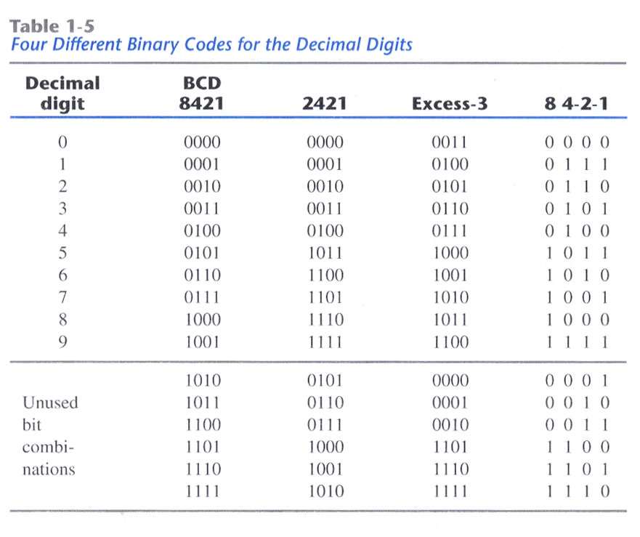
Other Decimal Codes
Weighted code
Each bit position is assigned a weighting factor
BCD code, 2421 code
Self-complementing code
9’s complement of a decimal number is obtained directly by switching 1 and 0.
2421 code, Execess-3 code
BCD code
Not self-complementing
2421 code
Some digits can be coded in two possible ways.
Excess-3 code
Unweighted code → Obtained from the corresponding binary plus 3

Slide 35
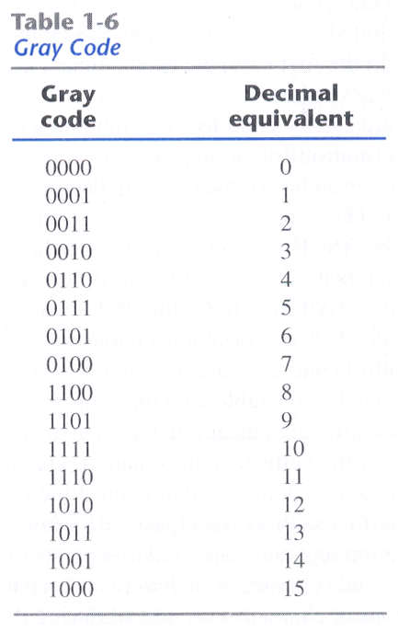
Gray Code
Gray code
An encoding of numbers so that adjacent numbers have a single digit differing by 1.
Used for Analog-to-Digital Converter
Used in application where an error or ambiguity may be produced during the transition.

Slide 36
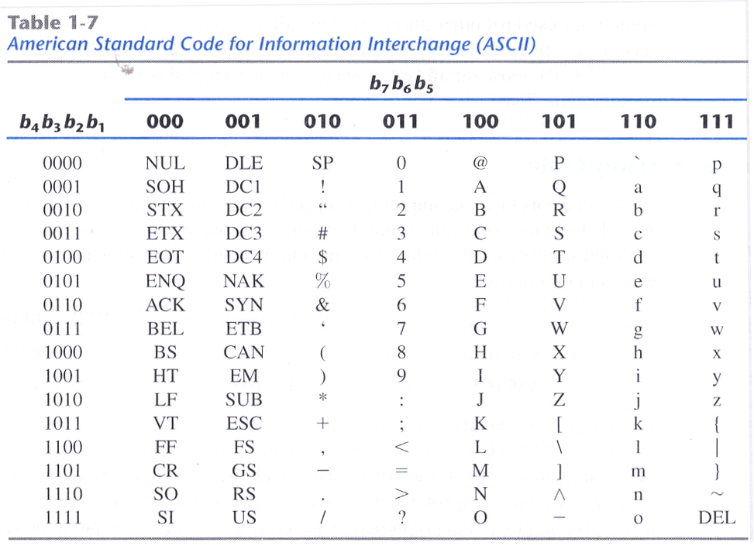
ASCII Character Code
Standard binary code for alphanumeric characters
Notes:
정보교환을 위한 미국 표준 코드이다. 현재 우리가 보는 대부분의 영문과 숫자 코드를 정의함. 7-bit로 충분히 표현이 가능하다. 모든 컴퓨터는 바이트 단위로 처리를 하므로 이 ascii코드도 8bit로 구현이 되면 추가로 얻어지는 코드는 특별한 목적의 응용에 사용이 된다. 즉 그리스 문자나 italic font등에 사용이 된다.

Slide 37
Error-Detecting Code
To detect errors in data communication or processing
Parity bit: extra bit which makes the total number of 1’s either even or odd.
Can detect any odd combination errors
Cannot detect any even combination errors
 | With even parity | With odd parity
ASCII A = 1000001 | 01000001 | 11000001
ASCII T = 1010100 | 11010100 | 01010100

Slide 38
Binary Storage
Binary cell: a device that possesses two stable states
Cell input: receives data and control signals that set it to one of the states
Cell output: physical quantity indicating which state the cell is in
States are encoded as binary digits {0, 1}

Slide 39
Registers
Group of n binary cells: an n-bit register
Register has 2^{n} states: all possible n-bit strings
Register state (or content) can be interpreted s value, ASCII, etc
Registers classified as two type of input and output – Serial and/or Parallel
Details on this later in the class

Slide 40
Register Transfer
Registers are interconnected
At a given time, content of one register transferred to another
Content may be transformed/changed during transfer
Transforming circuit is a data processing or data path element/circuit
Example: Keyboard to register to memory
Key strike: 8-ASCII to rightmost register
Key strike: register content shifted left
4 Key strides: content transferred to memory
Computer must be provided with two devices
Holding data: register
Manipulating binary variables: digital logic circuit

Slide 41
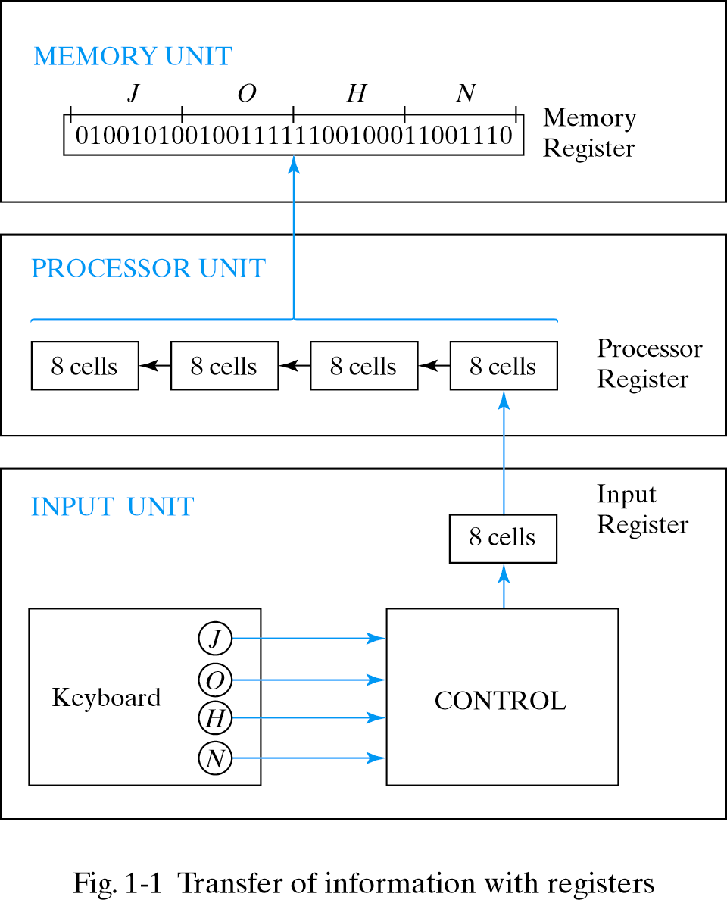

Slide 42
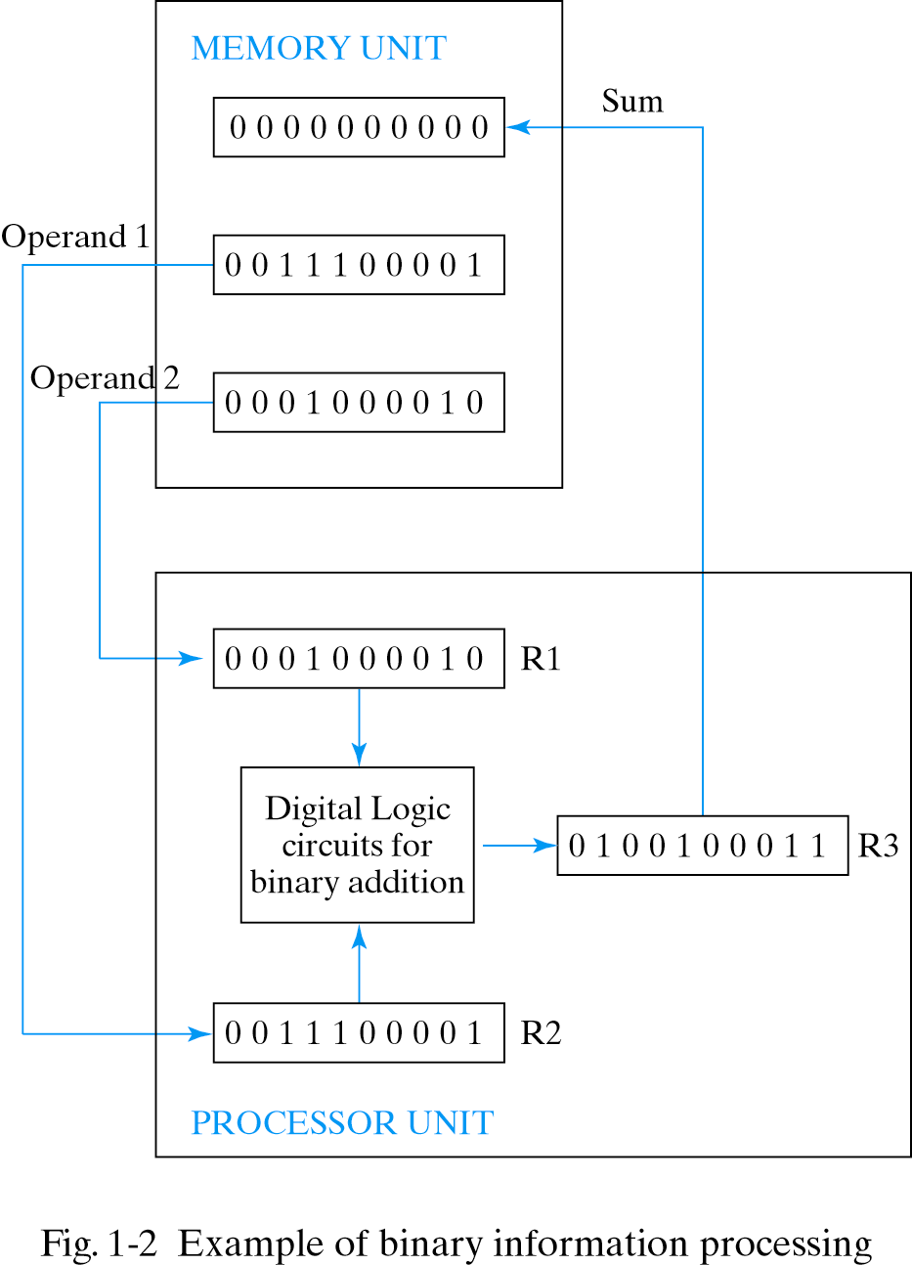

Slide 43
Binary Logic
Deals with variables that have two different values
→ typically bits {0, 1}
Logic is based on Boolean Algebra operators
Variables denoted by letters of alphabet
→ example: A, B, C, a, b, c, x, y, etc.
Three basic operations considered (for now)
AND (Boolean algebra multiplication)
OR (Boolean algebra addition)
NOT (Boolean algebra inversion)
More detail in following sections

Slide 44
Functions
Computers take inputs and produce outputs, just like functions in math!
Mathematical functions can be expressed in two ways:
We can represent logical functions in two analogous ways too:
A finite, but non-unique Boolean expression.
A truth table, which will turn out to be unique and finite.
An expression is
finite but not unique
A function table is
unique but infinite
f(x,y) = 2x + y
= x + x + y
= 2(x + y/2)
= ...

Slide 45
Binary AND Operation
Represented
by a dot or
By the absence of operator
x AND y is equal to z
z = 1 if and only if x AND y = 1,
otherwise z = 0

Slide 46
Binary OR Operation
Represented
by a plus sign between adjacent variables or constant
x OR y is equal to z
z = 1 if x = 1 OR y = 1 OR both x = y = 1,
otherwise z = 0

Slide 47
Binary NOT Operation
Represented
by a prime sign ’ or an overbar
Unary operator – operates on one variable
Not x is equal to z
if x = 1 Then z = 0 Else z = 1,

Slide 48
Boolean expressions
We can use these basic operations to form more complex expressions:
f(x,y,z) = (x + y’)z + x’
Some terminology and notation:
f is the name of the function.
(x,y,z) are the input variables, each representing 1 or 0. Listing the inputs is optional, but sometimes helpful.
A literal is any occurrence of an input variable or its complement. The function above has four literals: x, y’, z, and x’.
Precedences are important, but not too difficult.
NOT has the highest precedence, followed by AND, and then OR.
Fully parenthesized, the function above would be kind of messy:
f(x,y,z) = (((x +(y’))z) + x’)

Slide 49
Truth tables
A truth table shows all possible inputs and outputs of a function.
Remember that each input variable represents either 1 or 0.
Because there are only a finite number of values (1 and 0), truth tables themselves are finite.
A function with n variables has 2^{n} possible combinations of inputs.
Inputs are listed in binary order—in this example, from 000 to 111.
f(x,y,z) = (x + y’)z + x’
f(0,0,0) = (0 + 1)0 + 1 = 1
f(0,0,1) = (0 + 1)1 + 1 = 1
f(0,1,0) = (0 + 0)0 + 1 = 1
f(0,1,1) = (0 + 0)1 + 1 = 1
f(1,0,0) = (1 + 1)0 + 0 = 0
f(1,0,1) = (1 + 1)1 + 0 = 1
f(1,1,0) = (1 + 0)0 + 0 = 0
f(1,1,1) = (1 + 0)1 + 0 = 1

Slide 50
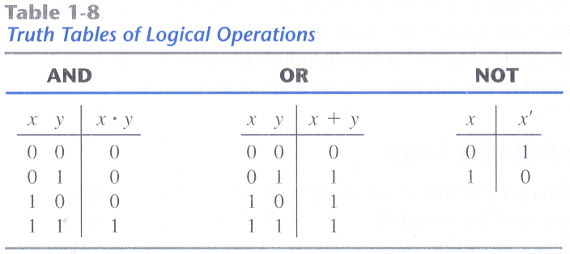
Truth Tables

Slide 51
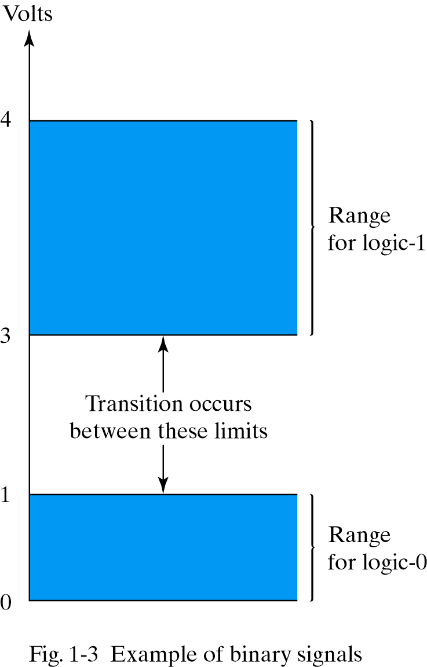
Logic Gates
Electronic circuits operate on 1 or more input signals to produce an output signal.
Output corresponding to a Boolean operation
Signals: voltages or currents
Interpreted as a 0 or 1
Defined by a range of voltage or current values

Slide 52
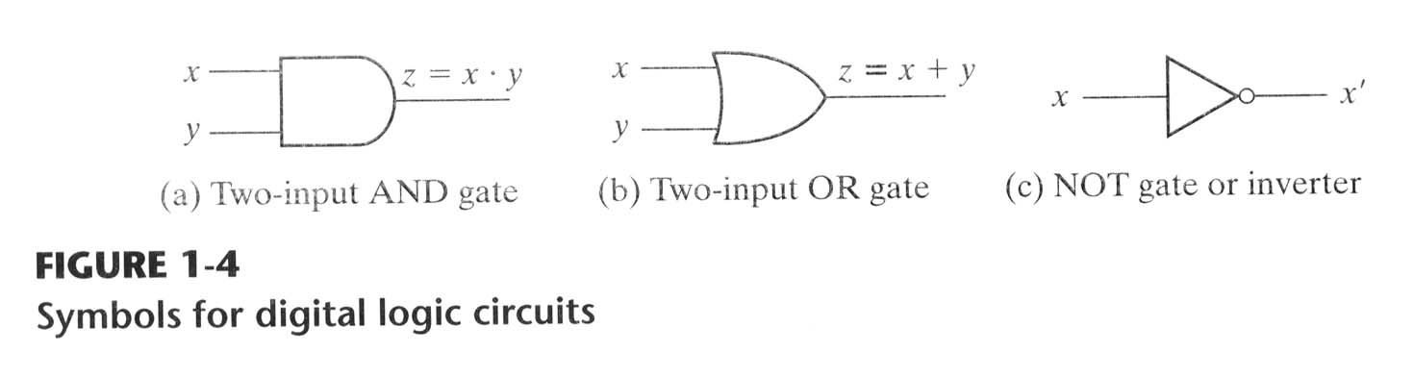
Logic Gates
Circuit diagrams use graphical symbols for logic gates
Connections of logic gates between registers can transform data
Logic gates represent interconnections of transistors and other electronic components

Slide 53
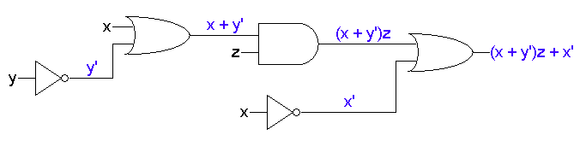
Expressions and circuits
Any Boolean expression can be converted into a circuit by combining basic gates in a relatively straightforward way.
The diagram below shows the inputs and outputs of each gate.
The precedences are explicit in a circuit. Clearly, we have to make sure that the hardware does operations in the right order!
(x + y’)z + x’

Slide 54
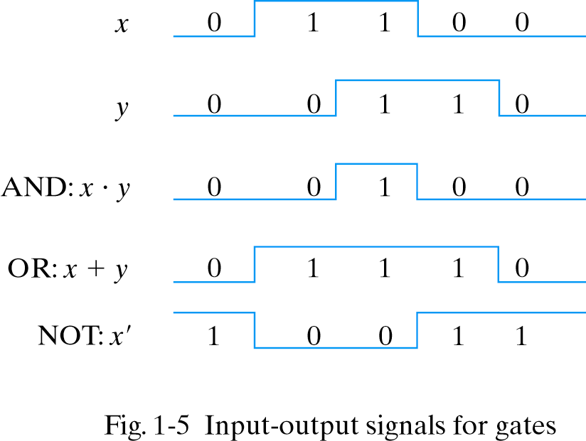
Timing Diagrams
Depict input and output signals as functions of time
Values toggle between two discrete variables

Slide 55
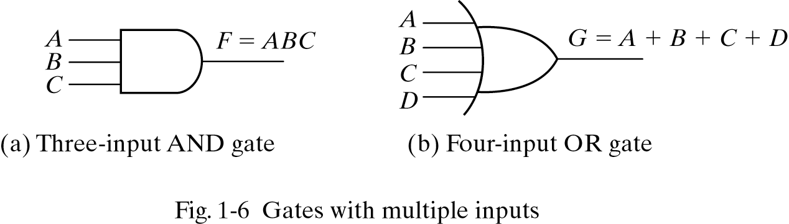
Multi-input Logic Gates
Can have more than one input
Examples: AND and OR gates

